Slide 1

Mental Wellness As We Age
Presenters:
- Prabhath Avadhanula, MD – Geriatric Psychiatrist
- Rhea Gupta – Undergraduate Student
- Bhavana Garg – Medical Student
- Jitender Sareen, MD – Psychiatrist
Learning Objectives:
1. Learn strategies for successful aging.
2. Recognize changes in mental health requiring medical attention.
3. Be aware of online and health system resources.
Date and Time: March 8th, 10:30 AM - 12:30 PM
Location: Hindu Seniors Centre, 834 Ellice Ave

Slide 2
Acknowledgements
Manitoba Hindu Seniors
Families
University of Manitoba
CBTm Hub

Slide 3

How many psychiatrists does it to take to change a light bulb?

Slide 4
How many psychiatrists does it to take to change a light bulb?
One but the light bulb has to WANT TO CHANGE

Slide 5
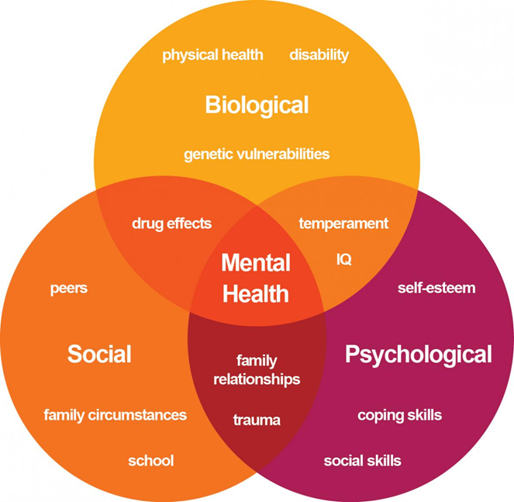
There is no health without Mental health
WHO

Slide 6
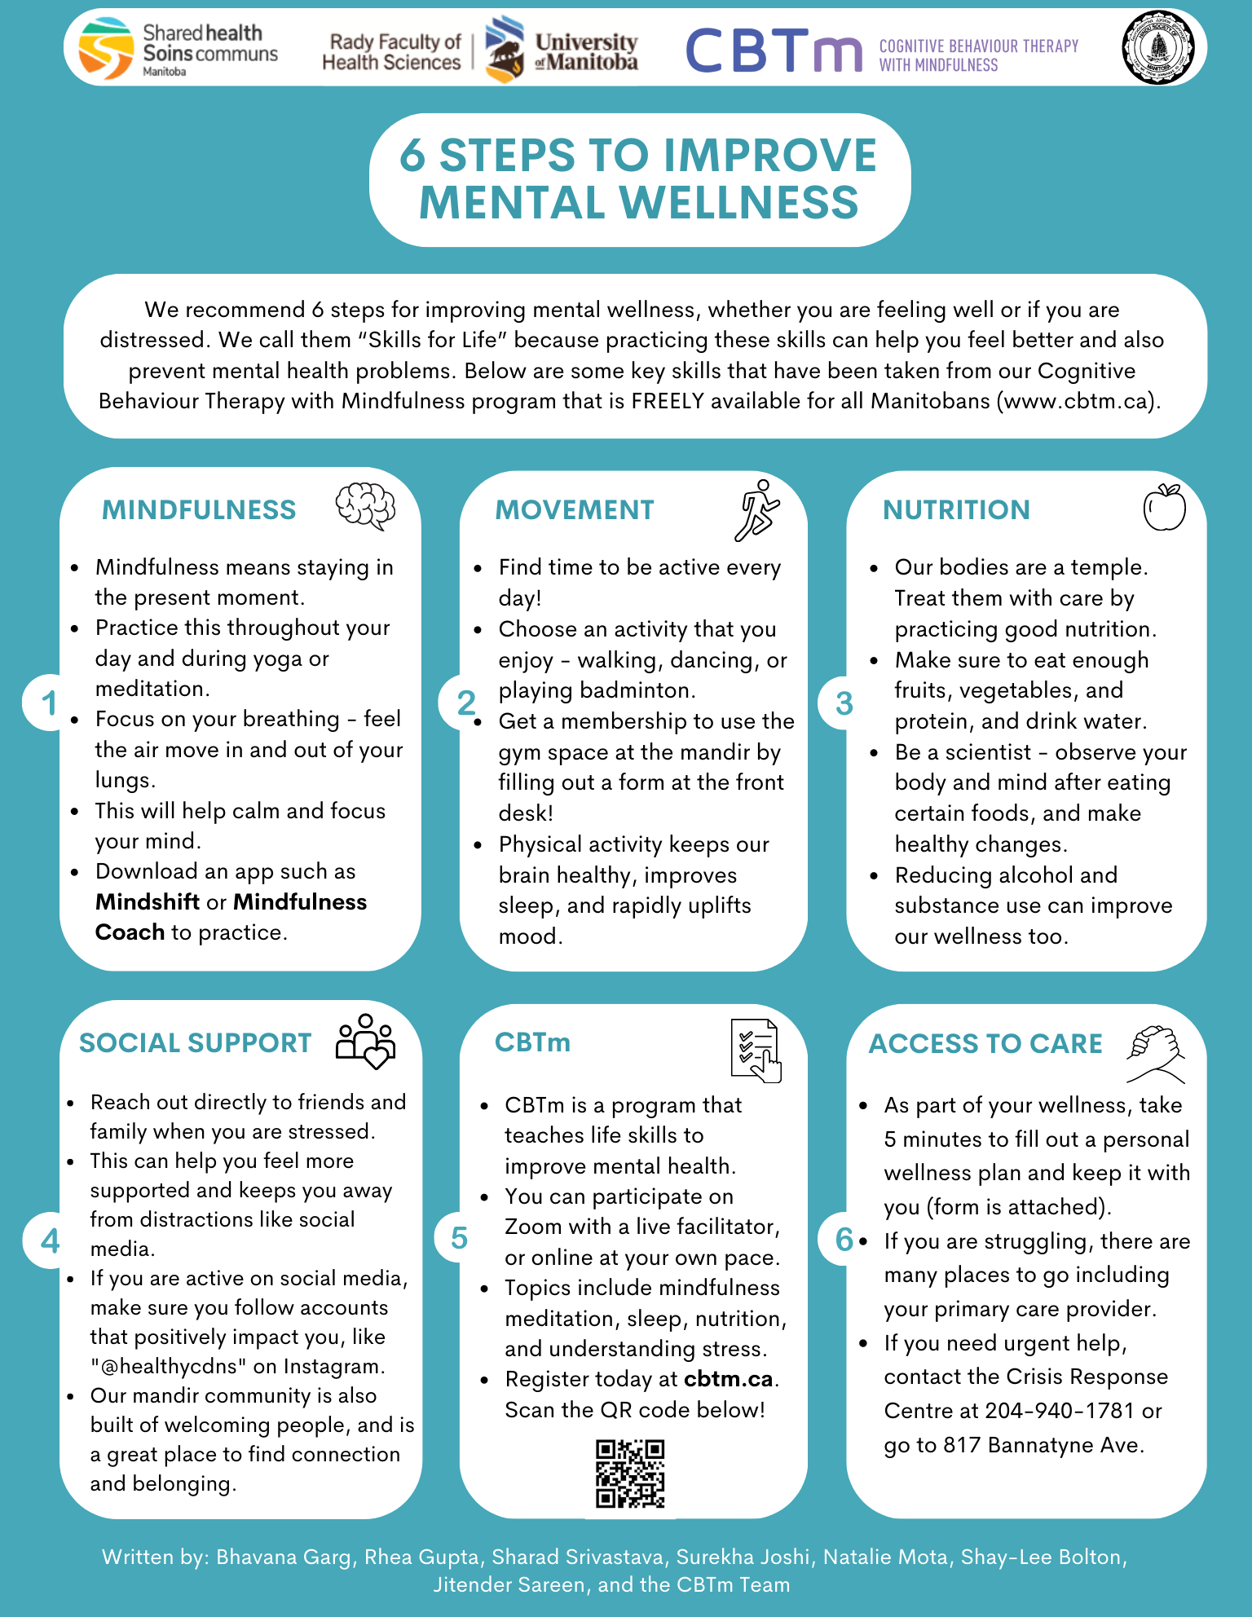

Slide 7
Healthy Coping
Managing stress
Talk
Good nutrition
Sleep hygiene
Socialize
Exercise
Ask for help
Do something you are good at
Develop coping strategies

Slide 8

Prabhath Avadhanula, MD
Dr. Avadhanula was raised in Ottawa and came to Winnipeg 12 years ago.
He and his wife Masumi have a 7 year old daughter Anya and a 9 year old son Neel.
Dr. Avadhanula did his Psychiatry residency at the University of Manitoba and has focused his work primarily in helping the elderly with their mental health needs with a focus on dementia.
He is the head of the Geriatric Psychiatry program at Selkirk Mental Health Centre and is also a consultant psychiatrist for the WRHA and IERHA health regions

Slide 9
Dementia
Dementia is not a specific disease. It is a general term used to describe a group of symptoms featuring a decline in cognitive abilities severe enough to interfere with a person’s daily life and independence. It is caused by damage to brain cells and affects memory, thinking, communication, and behavior.
It is not a normal part of aging, though age increases the risk.
Less than 1% of individuals 65 - 69 years old have dementia.
About 25% of individuals 85 years or older have dementia.
CIHI Data

Slide 10
Types of Dementia
Alzheimer’s Disease
Vascular Dementia
Lewy Body Dementia
Frontotemporal Dementia
Traumatic Brain Injury
Substance/Medication Induced
Parkinson’s Disease
Huntington’s Disease
HIV Infection
Prion Infection
Another Medical Condition

Slide 11
Dementia – What to Do ?
If you are worried about a decline in memory
  Remember some mild and occasional memory problems are normal with aging.
  Write down what you’ve noticed (e.g., forgetting names, misplacing items). Track when and how often it happens.
  If memory loss starts to affect your daily life or worry you, it’s important to take action.
  Talk to your doctor.
  Many causes of memory decline are reversible or treatable and may not be related to dementia.
  If it is something like dementia, early intervention can make a big difference in managing symptoms and maximizing independence, functioning, and quality of life.

Slide 12
Dementia – What to Do ?
Your family doctor may refer you to a specialist if needed
Alzheimer’s Society Of Manitoba is a great resource for education and support around dementia
Alzheimer’s Society of Manitoba
Address: 120 Donald St, Winnipeg, MB R3C 4G2
Phone: (204) 943-6622
https://alzheimer.mb.ca/
Adopt Brain-Healthy Habits . . .

Slide 13
Dementia – What to Do ?
Age And Opportunity
Address: 207 Donald St #200, Winnipeg, MB R3C 1M5
Phone: (204) 956-6440
https://www.aosupportservices.ca/
Seniors Resource Finders
https://wrha.mb.ca/support-services-to-seniors/seniors-resource-finders/
Adopt Brain-Healthy Habits . . .

Slide 14
Dementia – What to Do ?
Geriatric Program Assessment Teams (GPAT)
Geriatric Mental Health Teams (GMHT)
Central Intake line
(Tel) 204-982-0140, (Fax) 204-982-0144
https://wrha.mb.ca/rehabilitation/outreach-services/
Adopt Brain-Healthy Habits . . .

Slide 15

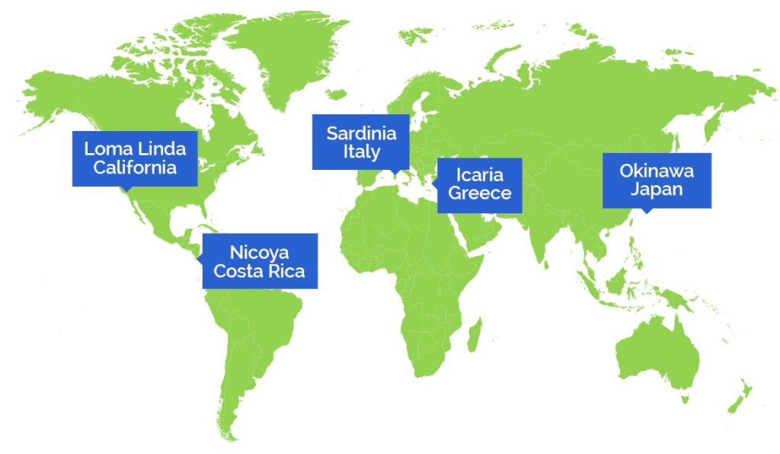
Blue Zones
Blue Zones are regions where it is claimed people live significantly longer lives.
These areas are located in Sardinia, Okinawa, Ikaria, Nicoya, and Loma Linda.
Common traits include healthy diets, active lifestyles, and strong social connections.

Slide 16
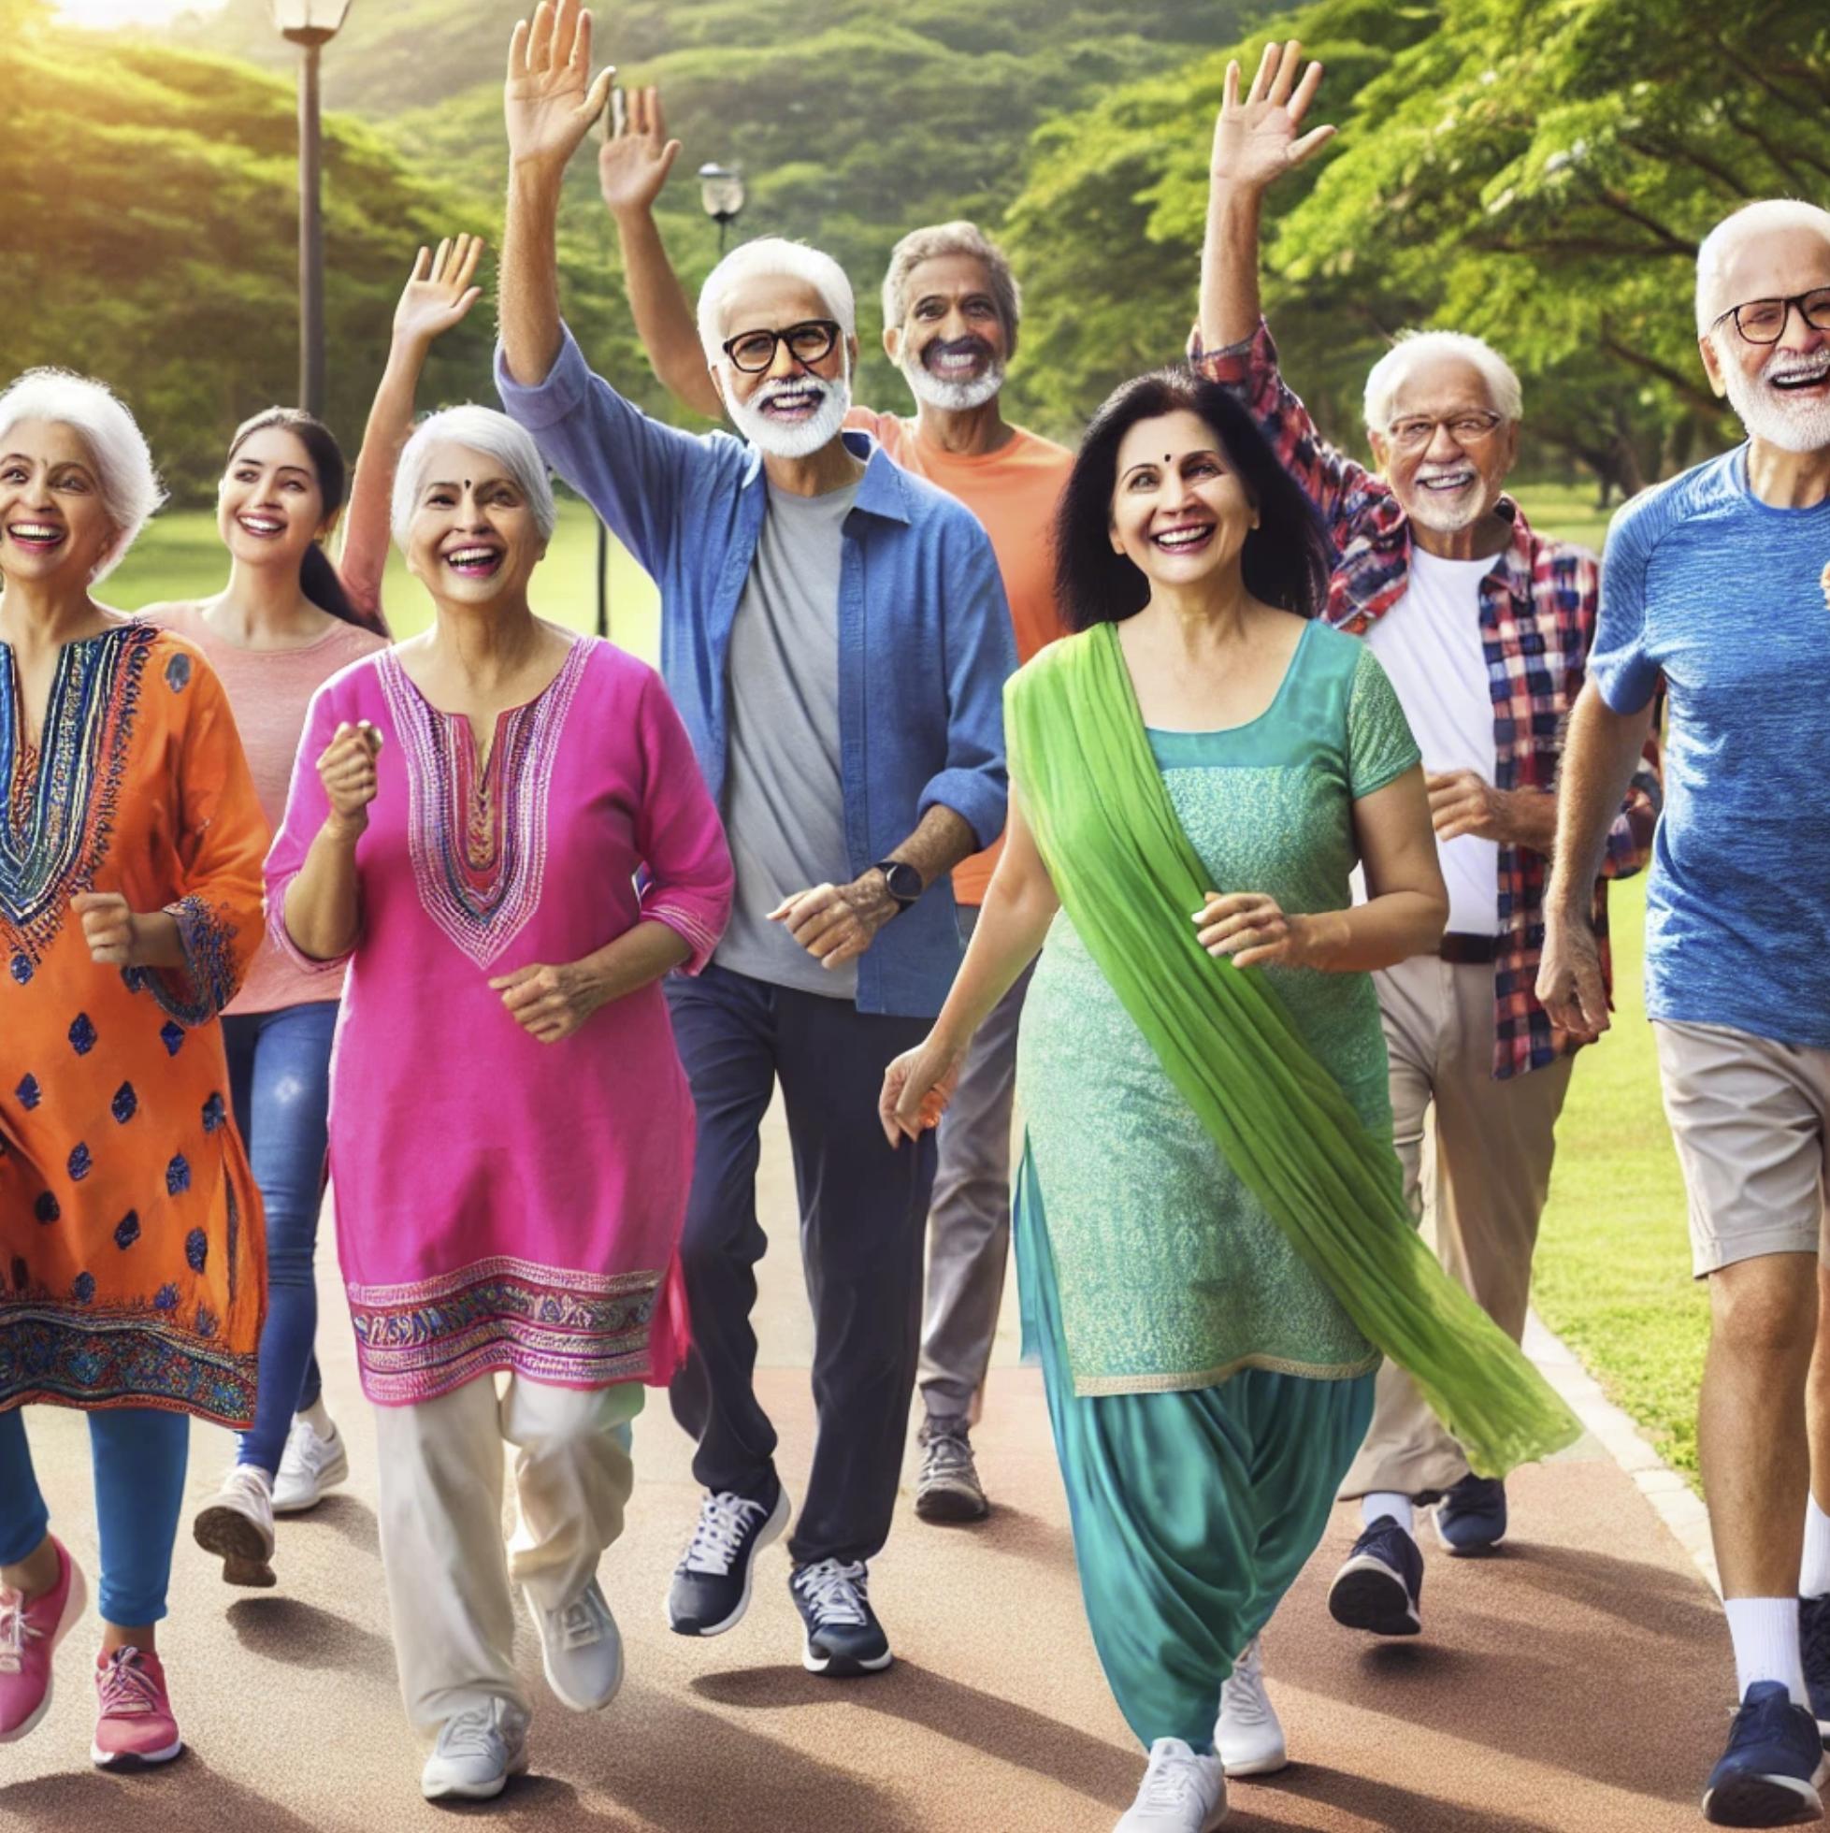
Modifiable Risk factors for Dementia — Lancet Commission on Dementia Prevention, Intervention, and Care 2024
45% of all dementia cases worldwide could be prevented or delayed by addressing 14 modifiable risk factors.

Slide 17
Modifiable Risk factors for dementia
Early Life
-Less Education
Midlife
-Hearing Loss
-High LDL Cholesterol
-Depression
-Traumatic Brain Injury
-Physical Inactivity
-Diabetes
-Smoking
-Hypertension
-Obesity
-Excessive Alcohol Use

Slide 18
Modifiable Risk factors for dementia
Late Life
-Social Isolation
-Air Pollution
-Visual Loss

Slide 19

Indian Cultural Superpowers For Brain Health

Slide 20
Jeevet Sharadah Shatam
May you thrive for a hundred years (or more) !

Slide 21
Rhea Gupta
Undergraduate Student,
University of Manitoba
Research Assistant, CBTmHub

Slide 22
Rhea Gupta
Rhea Gupta is a third-year undergraduate student in the Faculty of Science at the University of Manitoba.
She is deeply involved with both the seniors and Hindu communities, whether that be through volunteering at her neighbourhood’s retirement home, initiating a group called Sustaining Strength of Seniors during the COVID-19 pandemic, or learning Bharatanatyam dance.
Moreover, the support she has received from the Hindu Seniors Centre ever since she was only 8 years old has been monumental, as she has performed dances, made speeches, and played instruments here over the years, and is very happy to be back.
Two years ago, under the guidance of Dr. Sareen, Rhea started working for CBTm, or Cognitive Behavioural Therapy With Mindfulness, a 5-class program to help people gain mental health skills. These experiences also allowed her to conduct her own research project over the summer regarding the mental health of military members and veterans.

Slide 23

www.cbtm.ca
Freely Accessible to all Manitobans

Slide 24
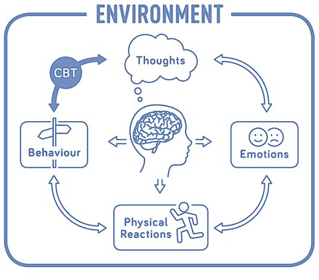
What is CBT?
Cognitive Behavioural Therapy
Psychotherapy that helps people shift unhelpful ways of thinking, feeling, and behaving
Learning to identify and monitor your thoughts
www.cbtm.ca

Slide 25
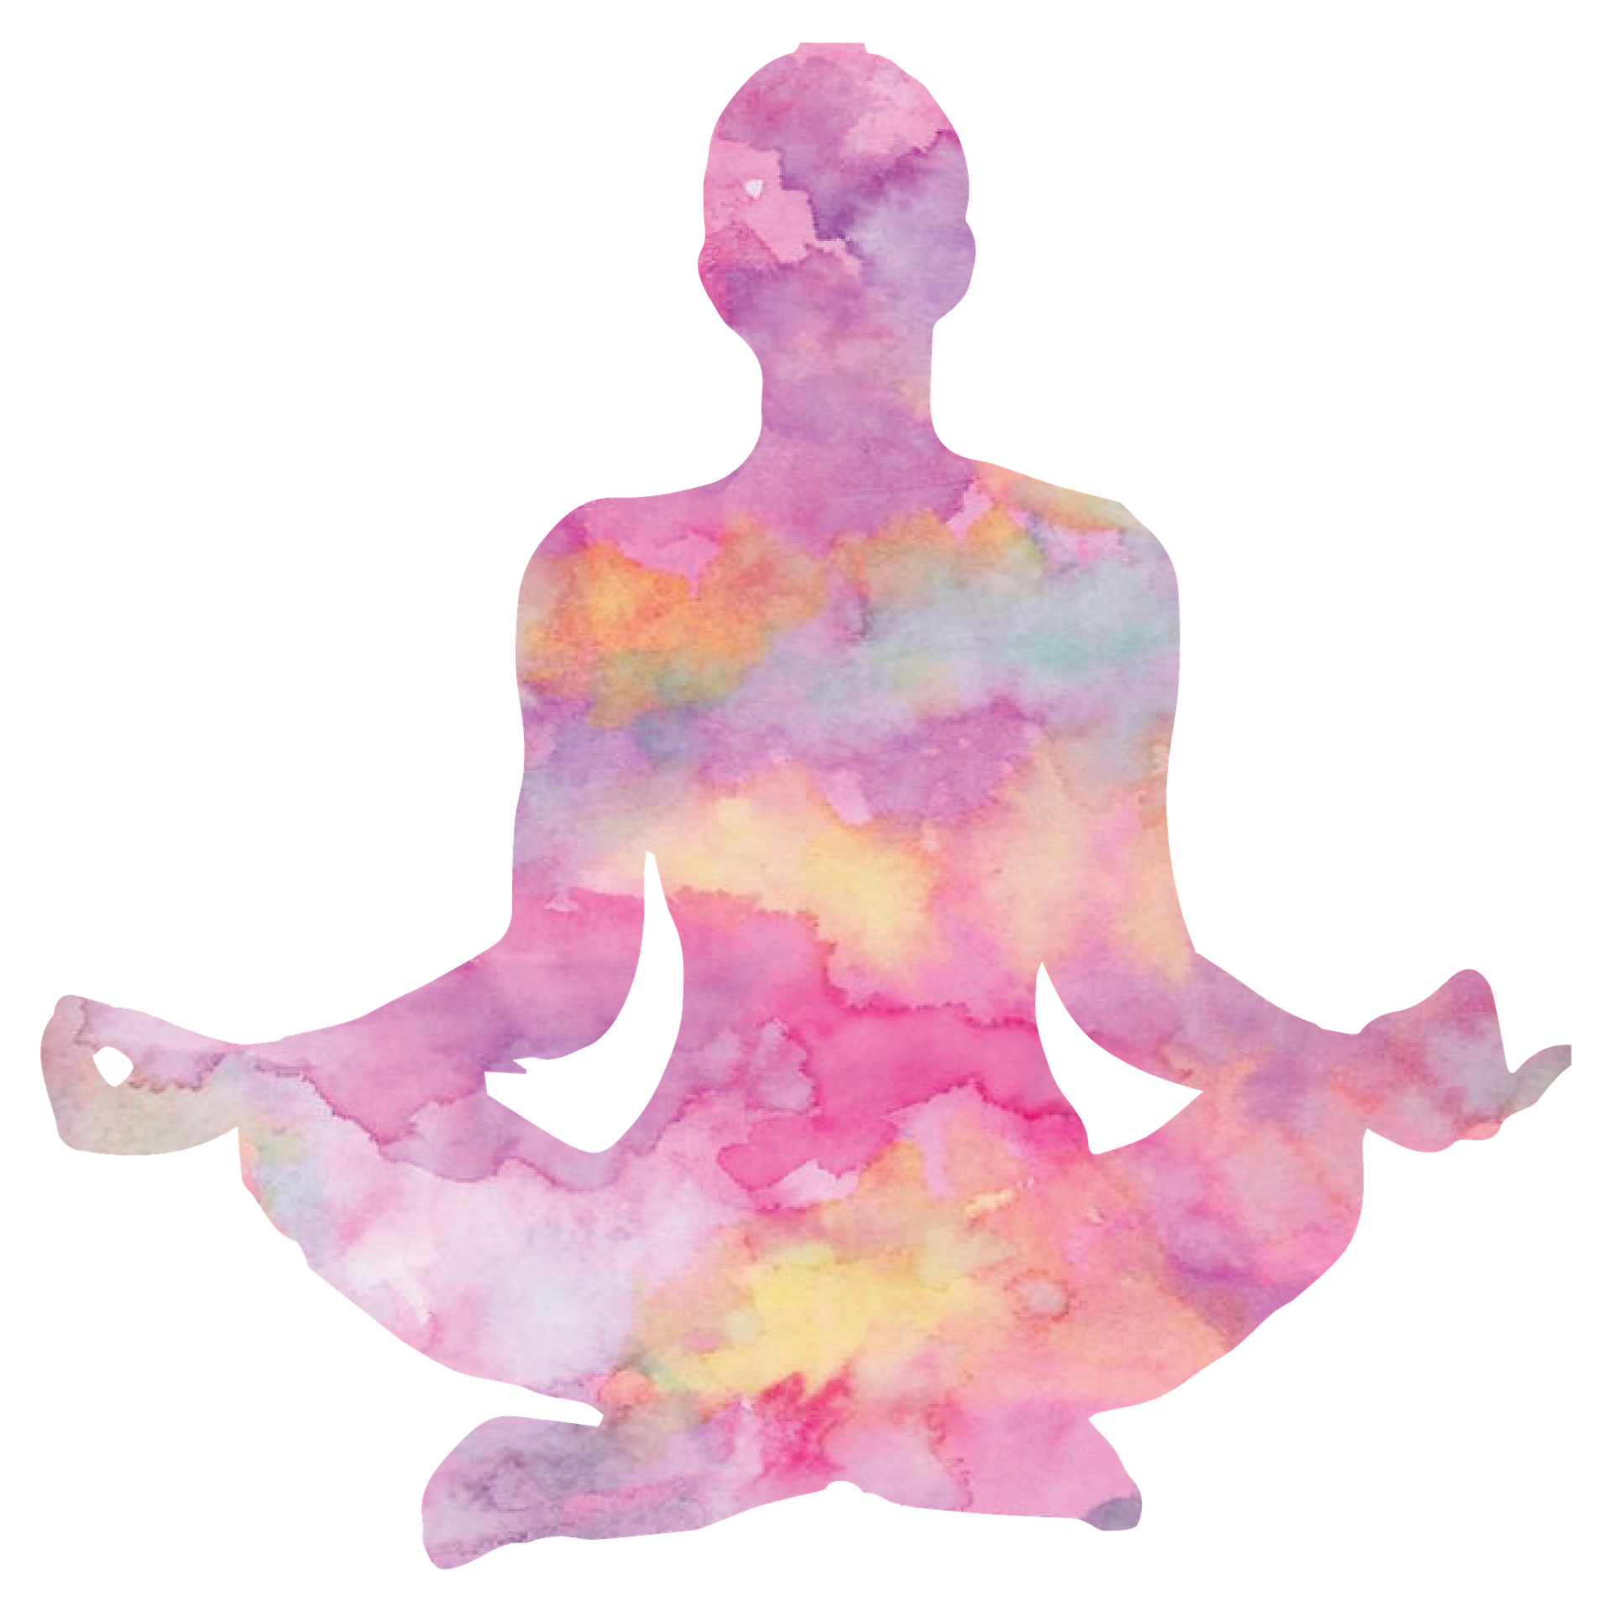
What is mindfulness?
Being aware of and accepting the current moment
    Body scans
    Breathing techniques
    Mindful eating
    Walking
    Meditation
www.cbtm.ca

Slide 26
Lack of access is a major barrier to mental health care
1 in 5 Canadians experience a mental illness each year (over 5 million people)
44% do not get treatment needs met
  Financial reasons
  Too busy
  Not sure where to go
  Vulnerable populations are least likely to get help (e.g., low income, youth, those without a primary care provider)

Slide 27
Solution:
Integration of Cognitive Behavioural Therapy with Mindfulness Program

Slide 28
CBTm
Selected key CBT skills
‘m’ for mindfulness
  Reduce stress, increase resiliency, improve emotion regulation, etc.
Class-based model
  Large vs. small group or individual format
Fewer (5 vs. 6-8) sessions, less intensive
www.cbtm.ca

Slide 29
Topics Covered in CBTm
Goal-setting skills
Relaxation strategies
Healthy living
  Sleep, nutrition, substance use, exercise
Problem solving and anger management
Healthy thinking
Thinking traps
www.cbtm.ca

Slide 30
SMART Goals
Specific
Measurable
Attainable
Timely
Relevant
www.cbtm.ca

Slide 31
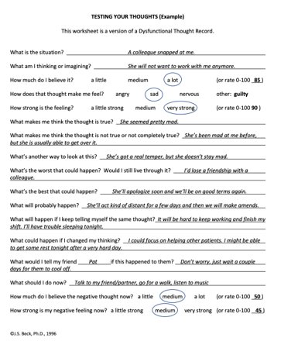
Thought Records
What is the situation?
What am I thinking?
How strong is the feeling?
What makes me think it's true?
What's another way to look at this?
What's the worst that will happen?
What will probably happen?

Slide 32
CBTm Program Format
90 minute classes - once a week, for 5 weeks
Zoom-based videoconference
    Led by a facilitator
    Group-based
    Weekly times
Web-based online course
    Self-directed
    No facilitator
    Complete at your own pace
www.cbtm.ca

Slide 33
Turning Pages
Adaptation of CBTm, catered to the needs of individuals 50+
Free of cost
Offered through Canadian Mental Health Association (CMHA)
Six in-person classes
www.cbtm.ca

Slide 34
Is CBTm right for me?
You want to learn skills to help improve your mental health
You struggle with anxiety and/or depressive symptoms
Your mental health is impacting your life in negative ways
www.cbtm.ca

Slide 35
Accessing CBTm
Visit www.cbtm.ca
Speak to your primary care provider
For Turning Pages, call (204) 982-6138

Slide 36
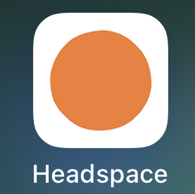
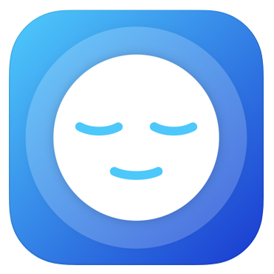
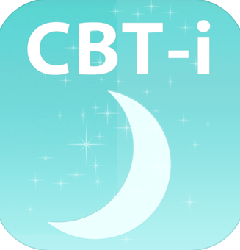

Helpful resources
Mindshift
Headspace
CBTi-Coach for Insomnia
Calm: Sleep, Meditate, Relax
www.anxietycanada.com www.heretohelp.bc.ca http://mbaddictionhelp.ca
https://www.sleepfoundation.org/insomnia/treatment
Notes:
Essence

Slide 37
Bhavana Garg
Bhavana is a third-year medical student at the College of Medicine at the University of Manitoba, with a profound passion for improving mental well-being within the community.
Her deep connection with her local mandir, where she has spent countless moments with her family, has inspired her to take meaningful action on an issue that is often overlooked—mental health.
As one of the primary authors of an important article on mental health in the Hindu darshan, she is proud to raise awareness and open up conversations in a community where such topics are rarely discussed.
In addition to her community efforts, Bhavana has dedicated the past two years to working with the CBTm team under the guidance of Dr. Sareen.
Her research, which focused on the benefits of Cognitive Behavioral Therapy for medical students and physicians, allowed her to attain a BSc Medicine degree this past summer.
In addition she had the honor of presenting her findings at an international conference in Halifax, an experience that only further fueled her commitment to improving mental health in the medical field.

Slide 38
Exercise and Mental Health
Notes:
So, today our team here will talk about a few things to help improve mental health. The one thing I will focus on today, is physical activity and exercise.

Slide 39
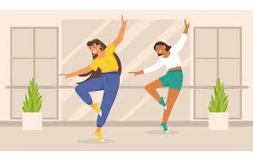
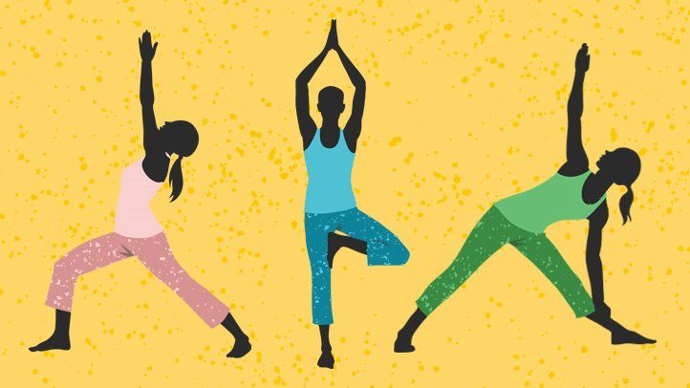
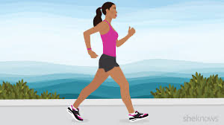
What types of exercise are good for the brain?
Notes:
Exercise itself can be a scary word in itself and some people’s minds jump right to this image of a body builder working out in a gym. But, in reality, there are lots of ways to be active that are beneficial to your health. You dont need to be in gym clothes, or be in a gym. Exercise will look differently for everyone in this room. I
It can range from stretching, yoga, walking around your home or mall, dancing, sports, or classic exercise on a treadmill, bike, or with weights.
Regardless of how you want to move, the most important part is to take time everyday to be active.
Winnipeg can get very cold and so I know even for myself, activity can become more challenging in the winters. But ill explain why it is so important and necessary to keep active both in the summer and winters for our physical and mental health.

Slide 40

Reflect
Think back to a time where you were physically active
Notes:
I want you to think back to a time, and wonder if you have had this experience before, where you are feeling very low and want to lay down to watch your favourite show. Instead, you got up to go on a walk around or move around in some way.
Suddenly, afterwards, you probably felt more refreshed, have more energy, and you feel happier.
This is not a coincidence. It’s because moving our bodies and exercising releases chemicals in our brains that improve mood and keep our brain healthy.
Activity can be in any shape or form. The biggest thing, is to make an active effort to persistently integrate it into your life.

Slide 41
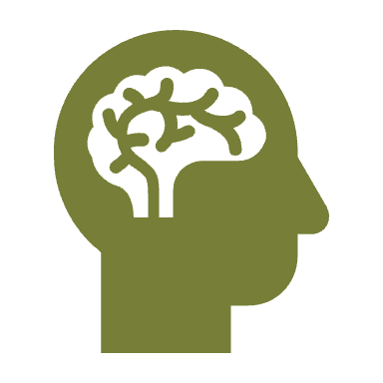
What benefit does exercise have on mental health?
Exercise is one way to improve our mood and keep our brain healthy
  Reduces stress
  Feel happier
  Strengthen memory
  Improves self-esteem
Notes:
So to start off, I want to speak regarding the benefits of exercise for the mind
One of these benefits includes reduced stress. Our lives can feel very busy and sometimes our mind is in a million places at once. But if you think back to when you last exercised, you might remember that your mind felt focused and more calm. Exercise reduces stress hormones in the brain, causing you to feel more relaxes.
Exercise also has a unique benefit of making us feel happier! There are many theories as to why this happens, but again, one of the hormones in the brain that keeps us happy is released when we exercise. As a result, exercise can help reduce symptoms of anxiety and depression and keep us happier overall.
Another benefit is improved memory. Exercise increased blood flow and oxygen to the brain and allows your memory to be strengthened.
Lastly, it helps improve self esteem. When we put our minds to a goal, such as even walking for 5 minutes, and we accomplish it, we feel a better self esteem and feel more confident in ourself. This is extremely imporant for our mental health.
These are just a few benefits to mental health, in addition to all of the physical benefits of exericse on your health, lungs, and body.

Slide 42

Make exercise a group activity!
Try to make exercise a group activity
Involve your friends and family
Notes:
Exercise is also a great social activity as well. We are very used to socializing by sitting down and eating a meal together or drinking chai. But I enocurage you to do physical activity with friends and family.
It will help you feel more motivated, on days when you don’t feel like being active.
One of my favourite activities is to go on walks with my friends and family during the summers in our neighbourhood. I therefore am improving my mental health by being active, and at the same time am laughing and talking to others which in itself has its own benefits.

Slide 43
Homework
Set a goal for yourself to be physically active everyday
Record how you feel before physical activity
Record how you feel after walking, yoga, dancing, playing cricket.
Notes:
So, I want you to do some homework
Dedicate a certain amount of time per day to be physcially active. It doesn’t need to be half an hour or an hour. Even 10-15 minutes to start will be sufficient. If you put time away to be active everyday, you will be more likely to be active, as many of us get very busy and forget to prioritize it.
Then record in a journal or on your phone, how do you feel physically and mentally before exercising.
Once you do your activity, record again how you feel after.
The best way to make changes to our behaviour, is for us to see the benefit for ourselves. So take this opportunity to see all of the benefit in your life. Once you do, I can garauntee you will continue to make sure exercise is a priority.

Slide 44
Jitender Sareen
Psychiatrist
University of Manitoba
CBTmHub

Slide 45
Objectives
Learning strategies to recognize wellness to illness
Busting some common myths
How to get care when you are someone else needs it

Slide 46
Mental Health worsens as we age?
True or False

Slide 47
Mental Health worsens as we age?
False

Slide 48

People should retire by the age of 65 for their health
True or False

Slide 49
People should retire by the age of 65 for their health
False

Slide 50
Retirement?
Average age of Nobel Prize winners is Mid-60s
Retirement was only created 100 years ago
Most people reduced “work” as they age
Working is good for your mental health

Slide 51
What are the benefits of retirement on mental health?

Slide 52
What are the benefits of retirement on mental health?
Reduce Stress
More time for hobbies/socializing
Improve sleep and physical health

Slide 53
What are the challenges of retirement on mental health?

Slide 54
What are the challenges of retirement on mental health?
Loss of purpose
Social isolation
Cognitive decline

Slide 55
What can you do to improve your mental health during retirement?

Slide 56
What can you do to improve your mental health during retirement?
Strong social connections
Engaging in hobbies
Financial stability
Structure in your day
Volunteering

Slide 57
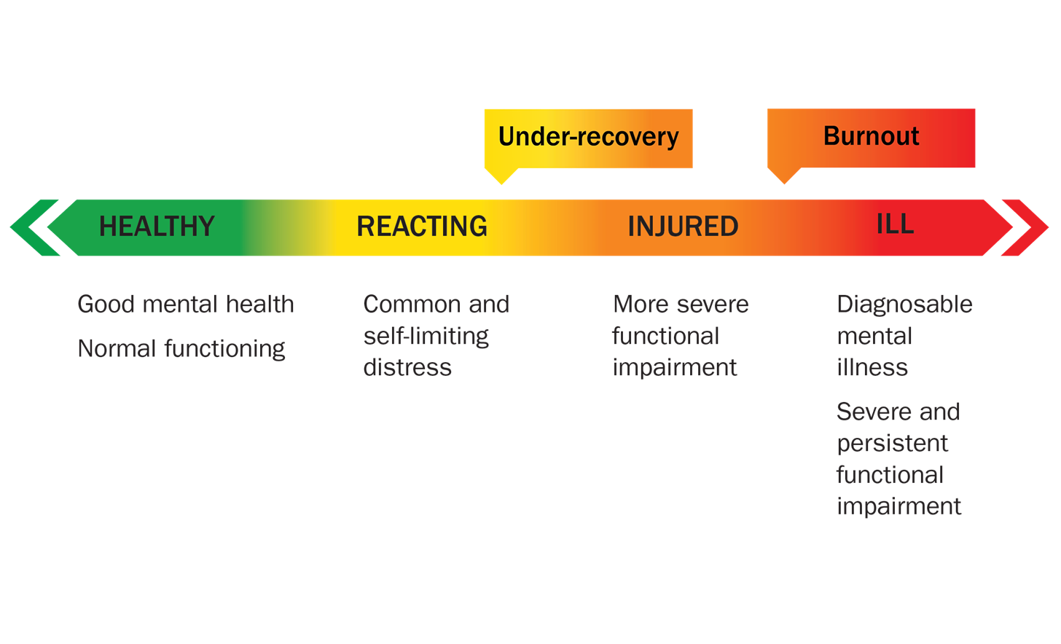
Mental Health/Performance Continuum Model
Road to Mental Readiness
Notes:
4 min
Just to further highlight the importance of recovery – we can look at how the impact of under-recovery can lead to burnout and mental health problems.
Have any of you seen this model before. Here is quick reminder. The model goes from healthy adaptive coping (green), through mild and self-limiting distress or functional impairment (yellow). It is important to note that yellow is normal, occurs often and does not impact performance, most people move back and forth between green and yellow given the stressors we are experiencing. If however, we move beyond the yellow zone we will start to experience more severe, persistent problems or impairment (orange), and beyond that is where we would clinical illnesses and disorders that require more concentrated medical care (red). The arrow over the four colour blocks indicates health is a continuum, and the state of one’s health can move back and forth on the continuum. Many people have physical and mental health problems that, when identified and treated early, can be temporary and reversible. Even if injured or ill, it is possible for one to be healthy and functioning.
It is helpful to use the mental health/performance continuum model, to better understand how stress can impact our mental health.
In regards to the role of recovery, if during the reacting phase we do not engage in adequate recovery activities to assist ourselves in bouncing back into the green or healthy zone, we risk moving into the orange or injured zone and eventually suffering the impact of burnout and/or a diagnosable mental illness.
Individuals differ with respect to specific recovery activities.
ACTIVITY: Write down four activities you do to recover from stress.

Slide 58
Download R2MR App on Phone
Can be found on Google Play Store for Android phones or App Store for IPhones
Take a few minutes to rate yourself over the last 2 weeks
  Select Continuum → Start → Choose an area of life (e.g. Mood) → Use slider to rate your experience over the last 2 weeks

Slide 59

MD Calc App
Depressive symptoms
PHQ-9
Anxiety symptoms
GAD-7
Alcohol use
AUDIT-C
These free online tools can be used privately and can help you monitor distress

Slide 60
Stepped care for accessing help
1. Friends, Family
2. Family Doctor
3. Mental Health Specialist
Notes:
Essence

Slide 61
Supporting Others
How do I know when to help?
Some signs that a friend or family member may have a mental illness and could need help are:
They suddenly no longer have interest in hobbies and other interests they used to enjoy
They seem to feel angry or sad for little or no reason
Their sleep patterns have changed
Notes:
Essence

Slide 62

What do you do for your wellness?
What is the one thing you will do to improve your wellness after this session?

Slide 63
Mental Wellness As We Age
Presenters:
- Prabhath Avadhanula, MD – Geriatric Psychiatrist
- Rhea Gupta – Undergraduate Student
- Bhavana Garg – Medical Student
- Jitender Sareen, MD – Psychiatrist
Learning Objectives:
1. Learn strategies for successful aging.
2. Recognize changes in mental health requiring medical attention.
3. Be aware of online and health system resources.
Date and Time: March 8th, 10:30 AM - 12:30 PM
Location: Hindu Seniors Centre, 834 Ellice Ave

